Slide 1





Media
Analysis
Presented by Group 1, ExcelR

Slide 2













Team
Arti
Aashnish
Jaideep
Ratna Kumar
Vaishnavi
Adnan
Karthik

Slide 3




Content
1
Facebook
2
Google
3
LinkedIn

Slide 4


Modules
Excel
Tableau
MySQL
Power Bi

Slide 5

Facebook Ad KPI’s
Google Ad KPI’s
LinkedIn Ad KPI’s
Total Cost
Total Page Likes
Total Social Interaction
Total Post Interaction
Total People Reached
Total Impression
Total Link Clicks
Click Through Rate (CTR) %
Cost Per Purchase (CPP)
Conversion Rate (%)
Cost Per Lead (CPL)
Cost Per Person Reached
Return on Ad Spend (ROAS)
Total Ad Spend
Total Post Reactions
Impression
Clicks
Click Through Rate (CTR) %
Total Cost
Conversions
Conversion Rate
Cost Per Conversion
Conversion Value
Total Likes
Cost Per Click
Return on Ad Spend (ROAS)
Total Views
Total Comments
Total Reposts
Average Engagement Rate(%)
Total Reaction
Total Post
Total Followers

Slide 6
Facebook Ads Insights
High Total Impressions and People Reached indicate strong visibility, meaning ads are successfully entering user feeds.
Social Interaction and Post Interaction metrics suggest that content type influences behavior—creative quality and relevance are driving engagement peaks.
Google Ads Insights
High Click numbers with moderate Conversion Rate show that ads are attracting interest, but landing page experience may need optimization.
Strong Impressions indicate keyword coverage is broad, but conversion-focused keywords must be better prioritized.
LinkedIn Ads Insights
Strong performance typically on Engagement Rate due to professional relevance of the platform.
If Followers growth is high, brand visibility strategy is working.
High comments/reposts imply that content is authoritative and resonates with professional communities.

Slide 7
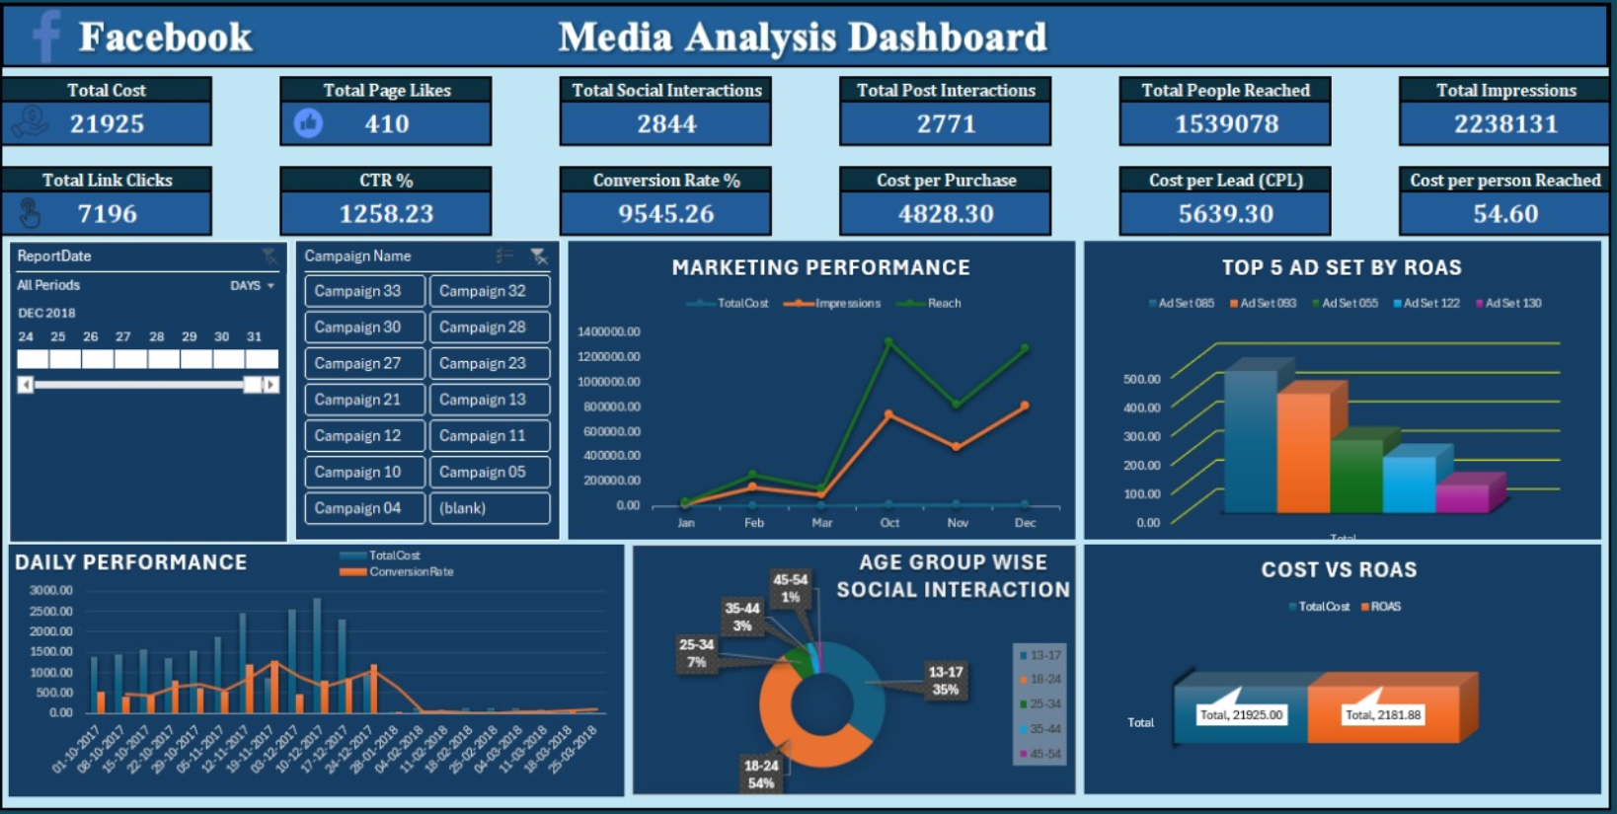
Excel

Slide 8
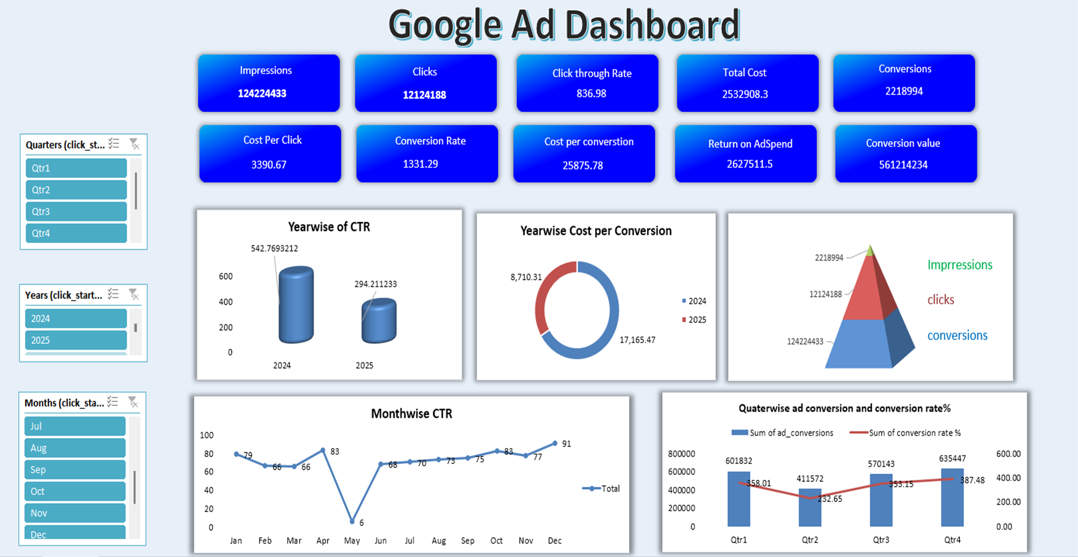
Excel

Slide 9
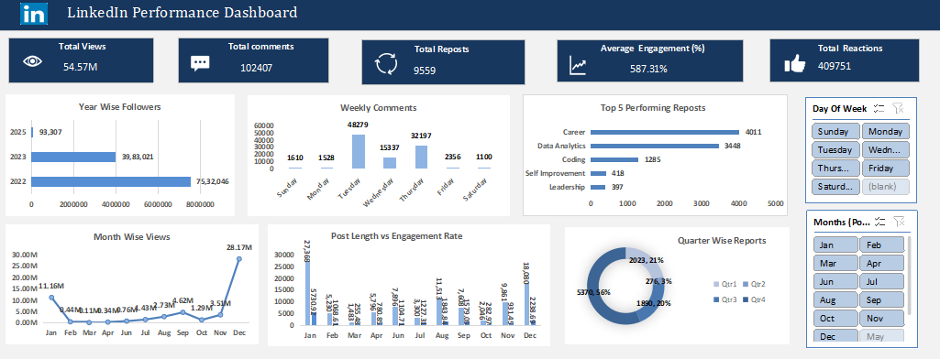
Excel

Slide 10
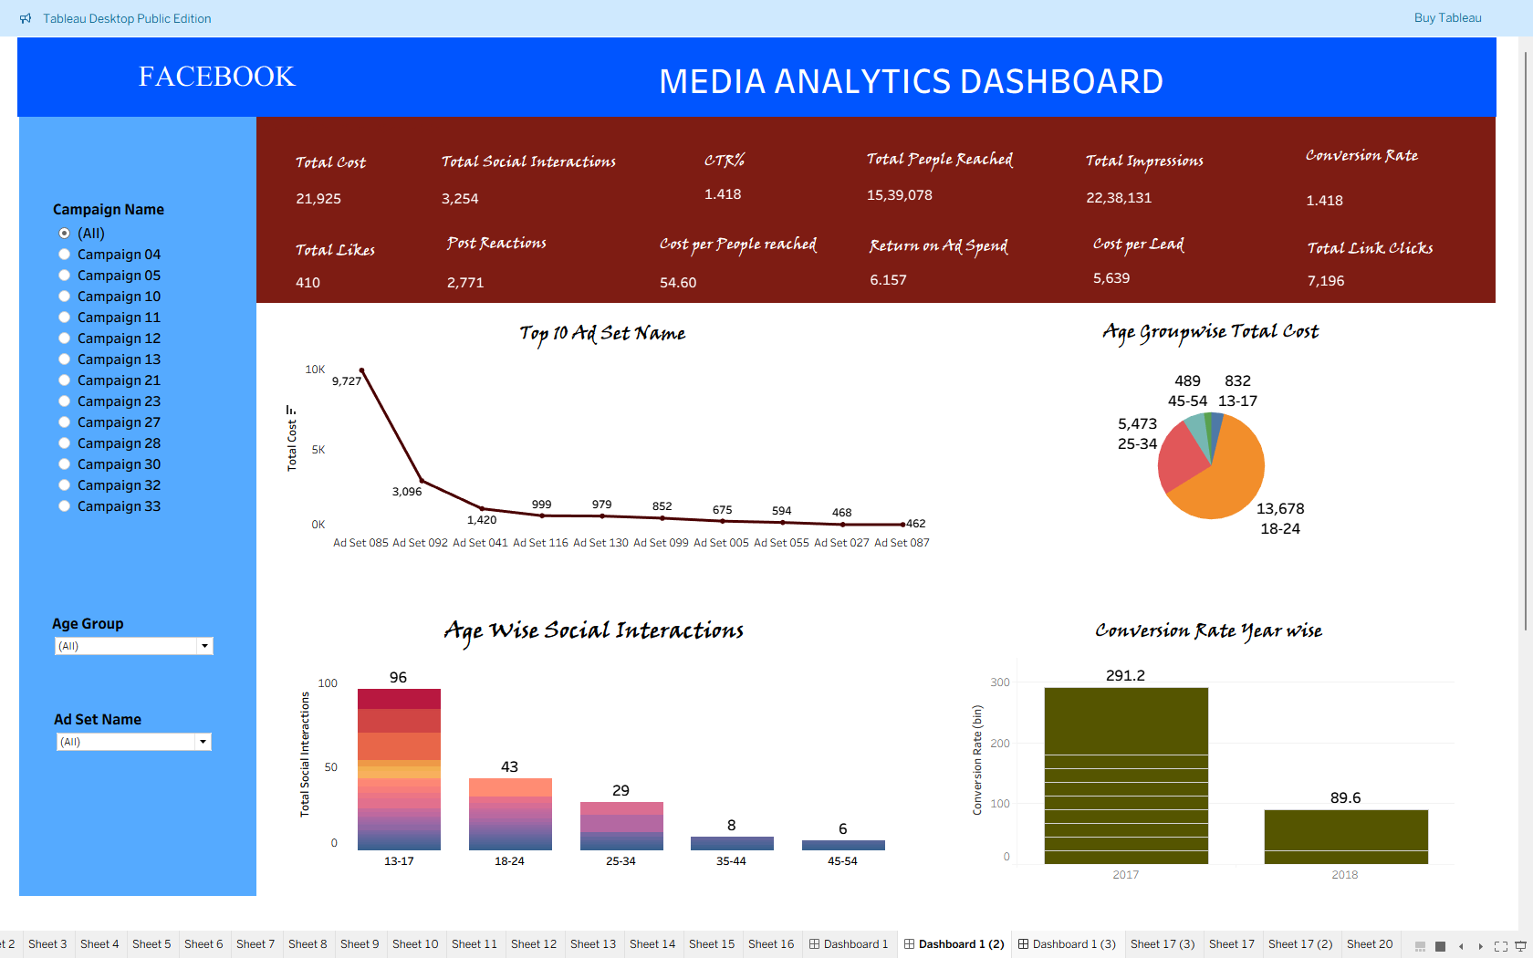
Tableau

Slide 11
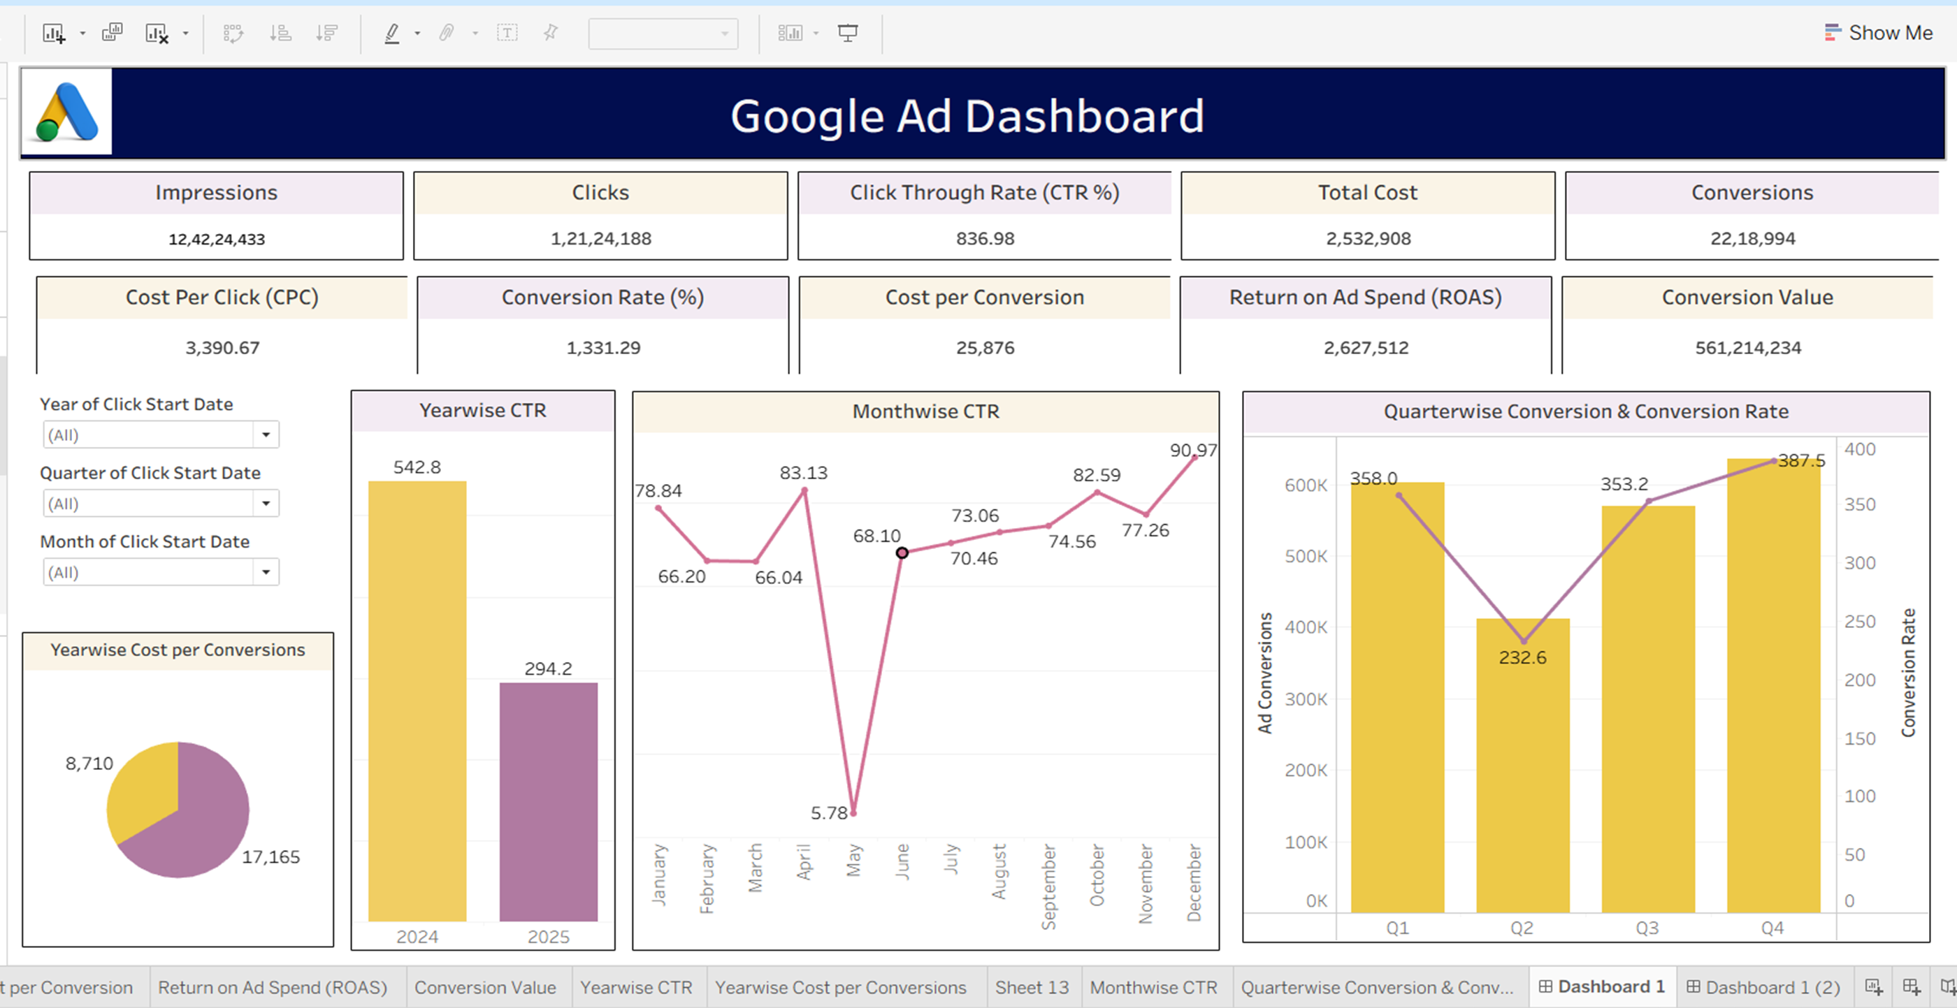
Tableau

Slide 12
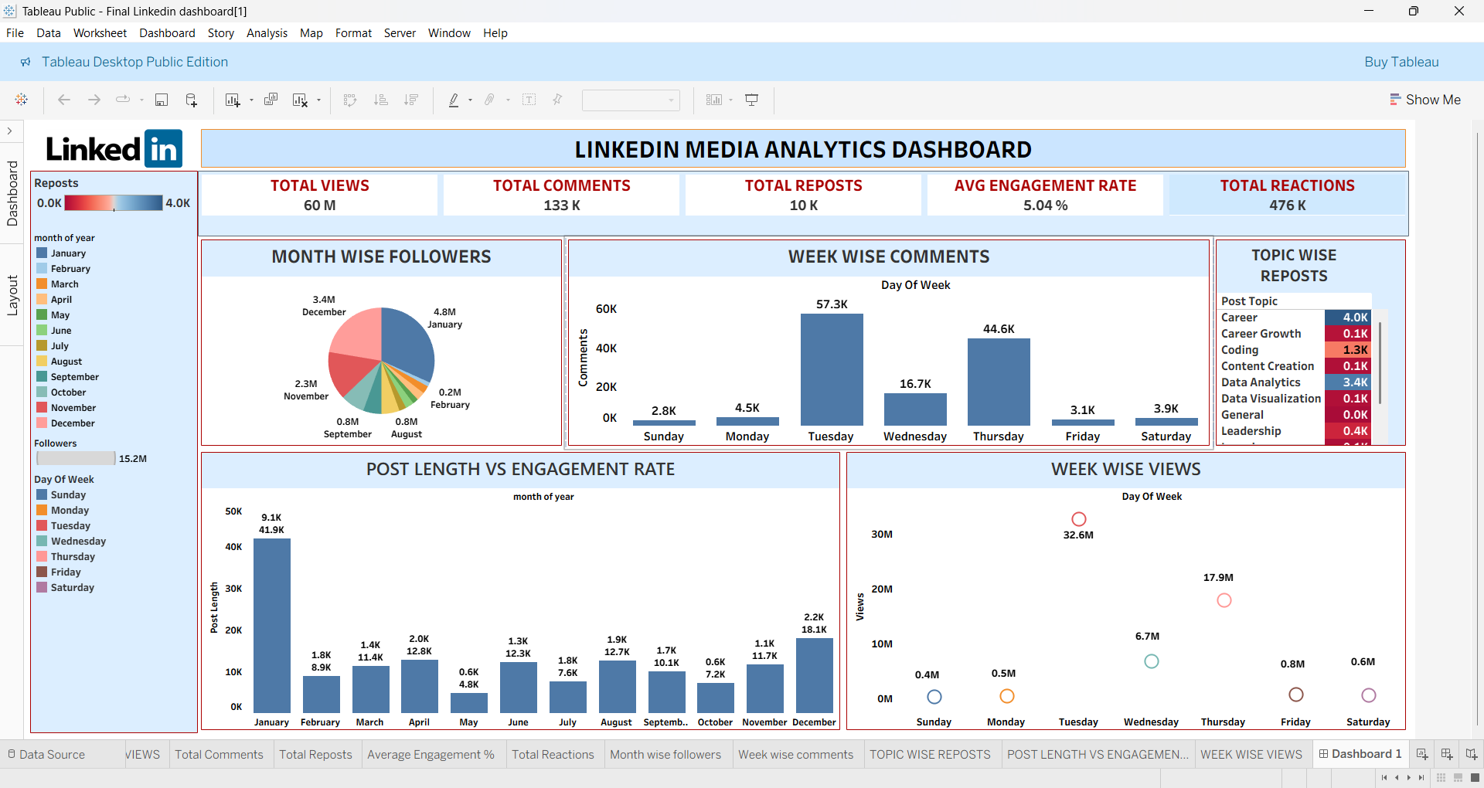
Tableau

Slide 13
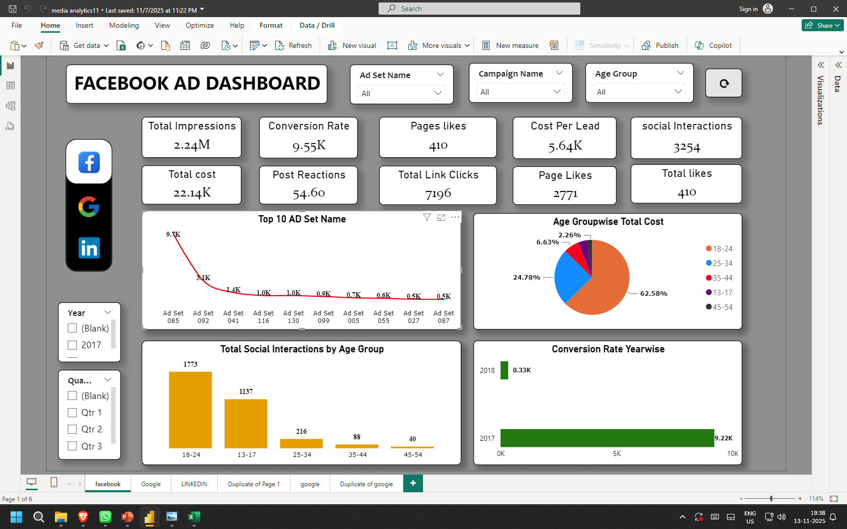
Power Bi

Slide 14
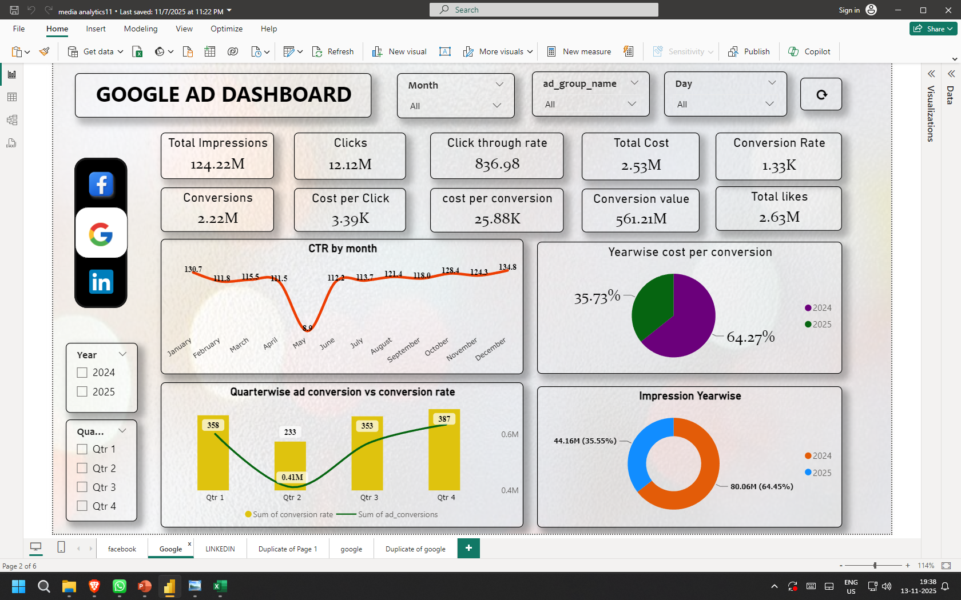
Power Bi

Slide 15
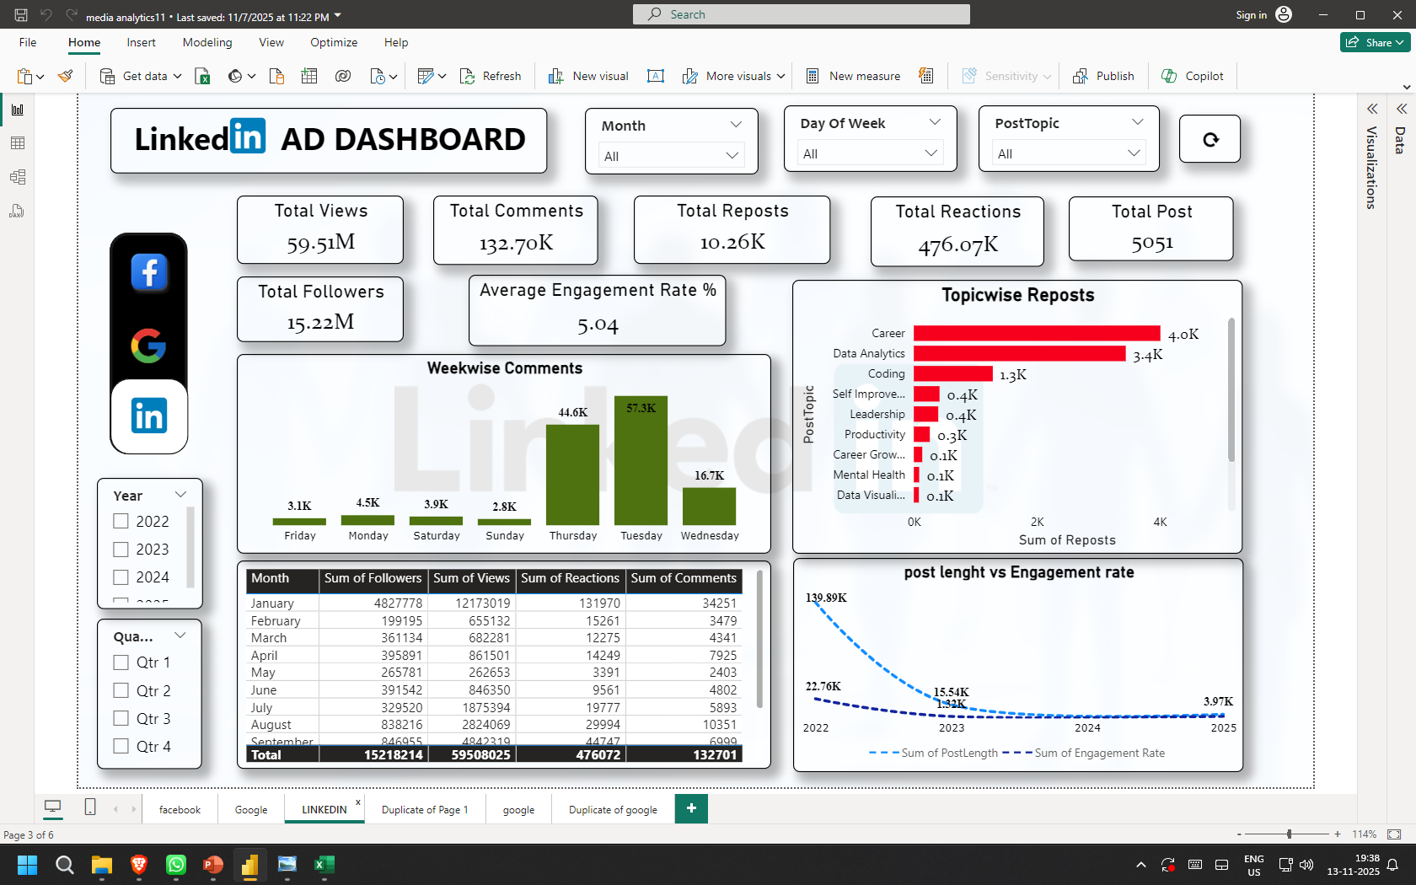
Power Bi

Slide 16
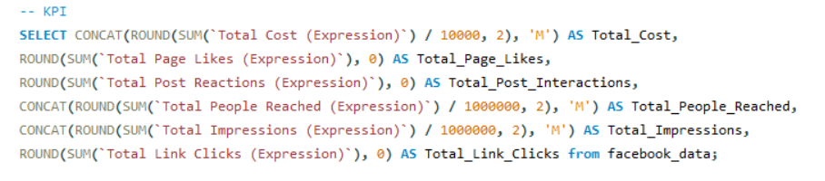

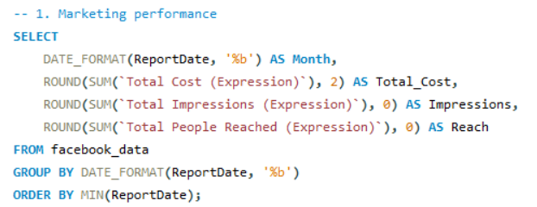
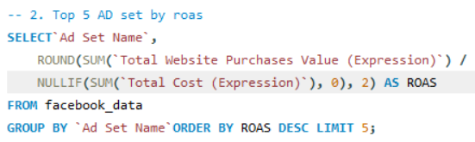
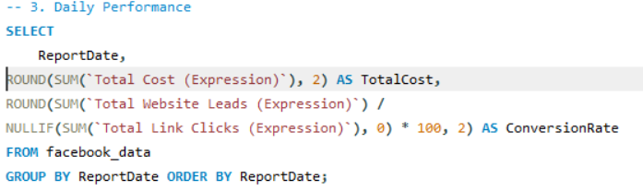
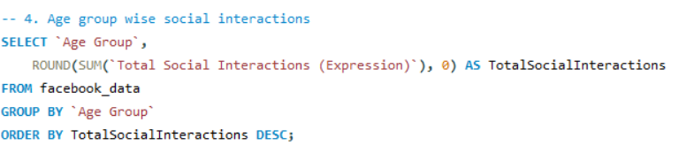
SQL queries
Facebook

Slide 17
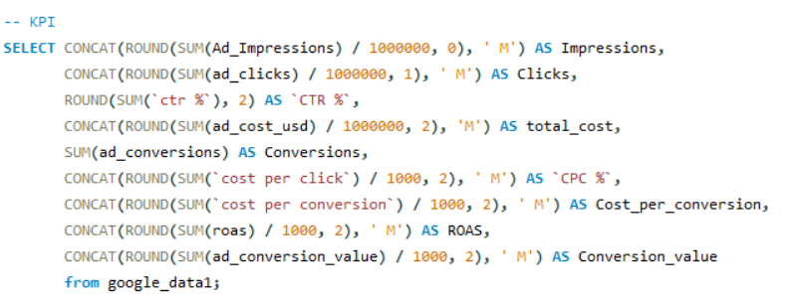
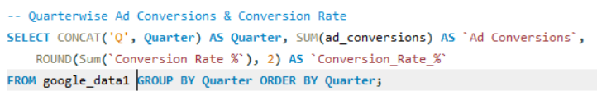
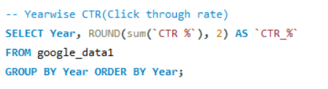
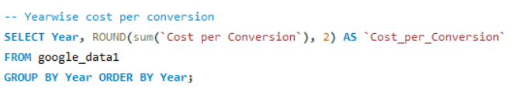
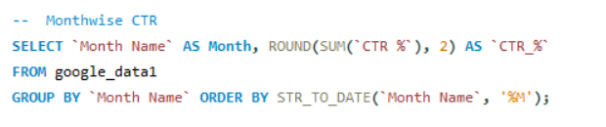
SQL queries
Google

Slide 18
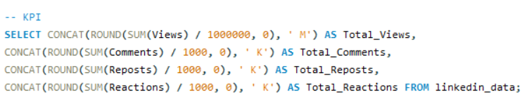
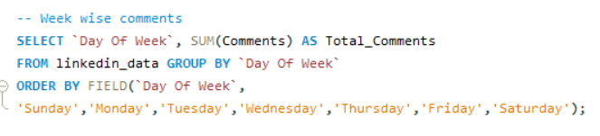
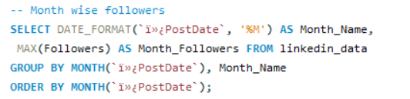
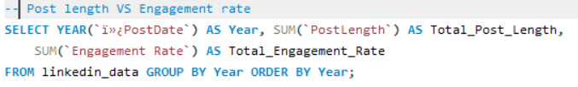
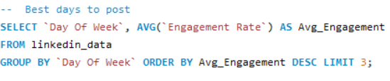
SQL queries
LinkedIn

Slide 19
Future Recommendations
Optimize Targeting and Bidding Strategies
Improve Landing Page Experience
Adopt Multi-Touch Attribution
Reduce Cost per Lead and Conversion
Conclusion
Multi-platform analysis reveals that leveraging data-driven insights across Facebook, Google, and LinkedIn significantly improves campaign efficiency and ROI.
By integrating insights from all three ad platforms, we demonstrate how structured analytics can optimize marketing performance and guide smarter decision-making.

Slide 20
THANK YOU

